Slide 1
Machine Learning
1

Slide 2
What is Learning?
“To gain knowledge or understanding of, or skill in by study, instruction or experience''
Learning a set of new facts.
Learning HOW to do something .
Improving ability of something already learned.

Slide 3
What is Machine Learning?
Machine Learning is the study of methods for programming computers to learn.
Building machines that automatically learn from experience.
Machine learning usually refers to the changes in systems that perform tasks associated with artificial intelligence AI Such tasks involve recognition, diagnosis, planning, robot control, prediction, etc.

Slide 4
What is Machine Learning?
Learning
algorithm
Trained
machine
TRAINING
DATA
Answer
?
Query

Slide 5
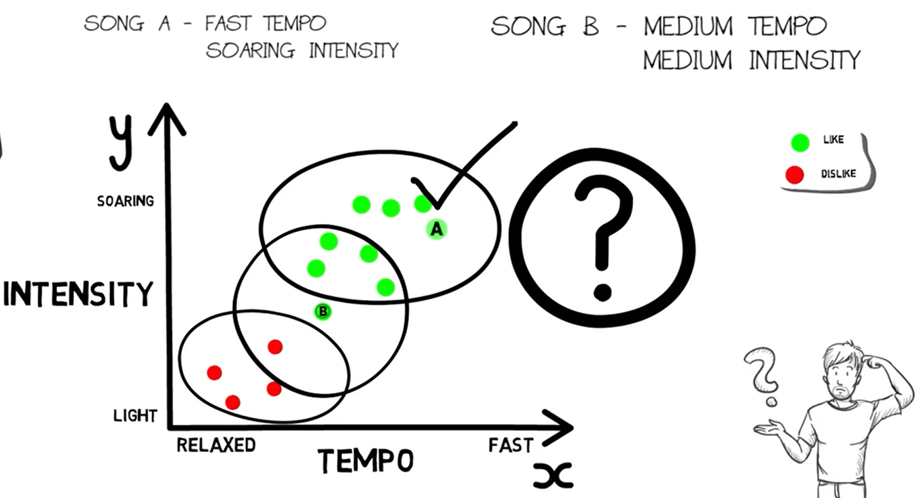

Slide 6
Steps in machine learning
Data collection.
Representation.
Modeling.
Estimation.
Validation.
Apply learned model to new “test” data

Slide 7
Terminologies
Model: A model is a specific representation learned from data by applying some machine learning algorithm. A model is also called hypothesis.
Feature: A feature is an individual measurable property of our data. A set of numeric features can be conveniently described by a feature vector. Feature vectors are fed as input to the model. For example, in order to predict a fruit, there may be features like color, smell, taste, etc.
Target(Label): A target variable or label is the value to be predicted by our model. For the fruit example discussed in the features section, the label with each set of input would be the name of the fruit like apple, orange, banana, etc.
Training: The idea is to give a set of inputs(features) and it’s expected outputs(labels), so after training, we will have a model (hypothesis) that will then map new data to one of the categories trained on.
Prediction: Once our model is ready, it can be fed a set of inputs to which it will provide a predicted output(label).

Slide 8
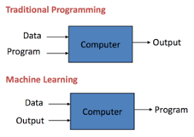
How it is different from traditional Programming
In Traditional Programming, we feed the Input, Program logic and run the program to get output.
In Machine Learning, we feed the input, output and run it on machine during training and the machine creates its own logic, which is being evaluated while testing.

Slide 9
Advantages of ML
Solving vision problems through statistical inference.
Intelligence from the common sense AI.
Reducing the constraints over time achieving complete autonomy.

Slide 10
Disadvantages of ML
Application specific algorithms.
Real world problems have too many variables and sensors might be too noisy.
Computational complexity.

Slide 11
Types of machine Learning
1) Supervised Learning.
2) Unsupervised Learning .
3) Semi-Supervised (reinforcement).

Slide 12
Supervised Learning
Supervised learning is a category of machine learning that uses labelled datasets to train algorithms to predict outcomes and recognize patterns.
Email Filtering, Credit Scoring, Voice command Recognition

Slide 13
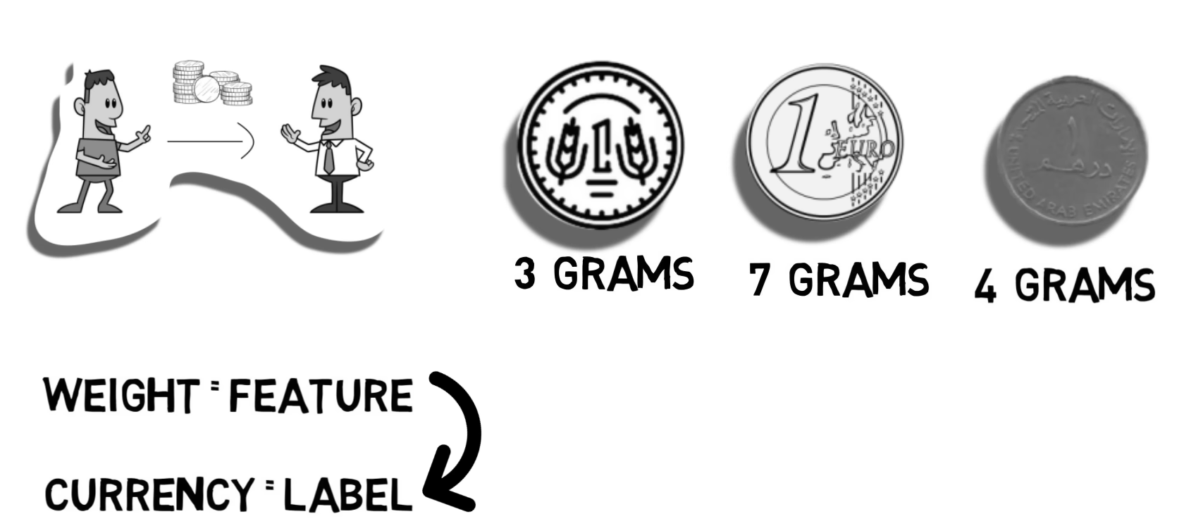
Supervised Learning

Slide 14
Unsupervised Learning
Studies how input patterns can be represented to reflect the statistical structure of the overall collection of input patterns
No outputs are used (unlike supervised learning and reinforcement learning)
Learner is provided only unlabeled data.
No feedback is provided from the environment
Clustering, Association
Recommendation engines, Customer segmentation, Fraud detection

Slide 15
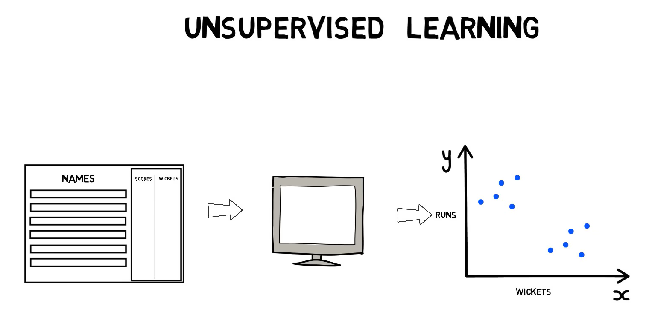

Slide 16
Unsupervised Learning
Advantage
Most of the laws of science were developed through unsupervised learning.
Disadvantage
The identification of the features itself is a complex problem in many situations.

Slide 17
Semi-Supervised (reinforcement)
it is in between Supervised and Unsupervised learning techniques the amount of labeled and unlabelled data required for training.
With the goal of reducing the amount of supervision required compared to supervised learning.
At the same time improving the results of unsupervised clustering to the expectations of the user.

Slide 18
Semi-Supervised (reinforcement)
Most people follow a similar process for learning new things: receive the information, process it, try it out yourself, and receive feedback on how it went. A lot of this process is also bolstered by rewards and punishment: if you answer correctly, you get a gold star, an extra point, or a higher grade. If you answer incorrectly, you lose points, leave the competition, or must repeat the exercise.

Slide 19
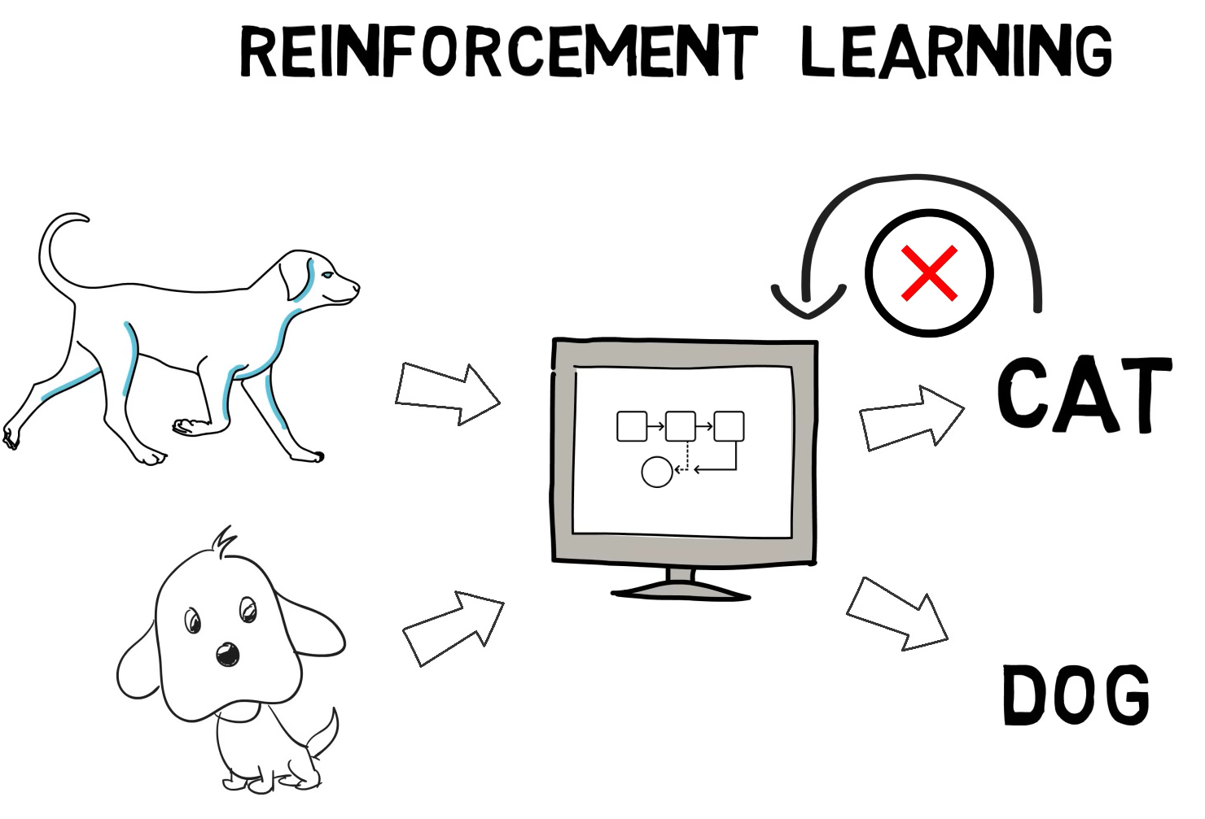
Notes:
through trial and error.

Slide 20
Applications
of
Machine Learning

Slide 21

Drug discovery

Slide 22
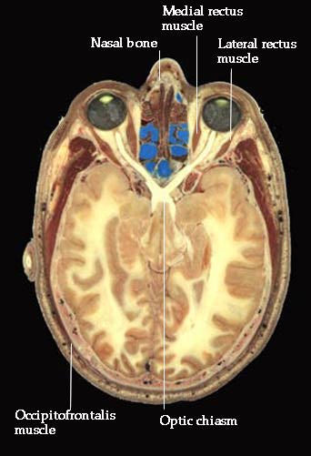
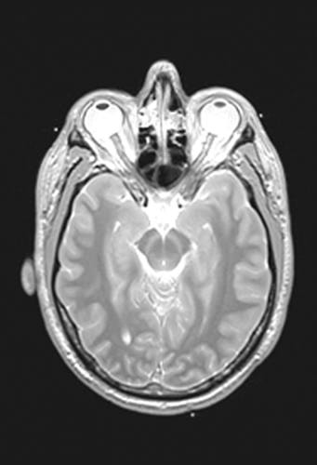
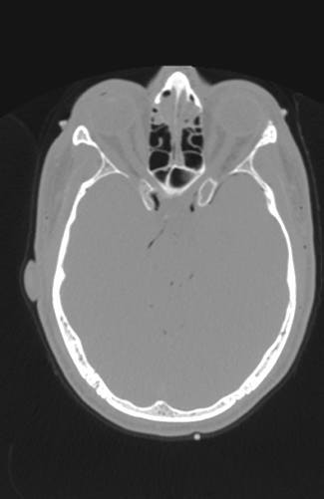
Medical diagnosis
Photo
MRI
CT
Notes:
22

Slide 23

Iris verification

Slide 24
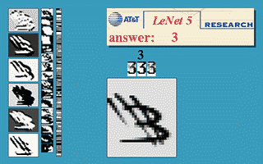
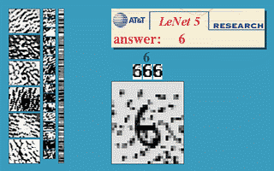
Hand-written digits

Slide 25
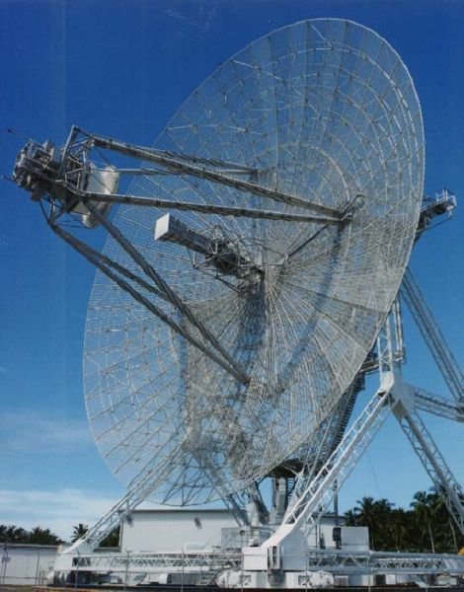
Radar Imaging

Slide 26
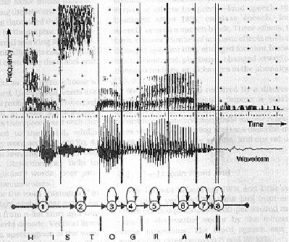
Speech Recognition

Slide 27
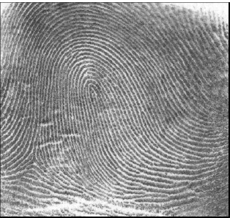
Finger print
fingerprint image

Slide 28

Signature Verification

Slide 29
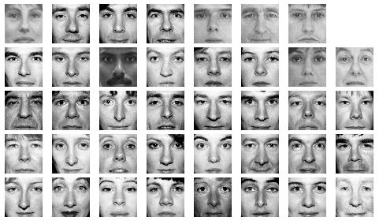
Face Recognition

Slide 30
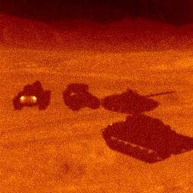
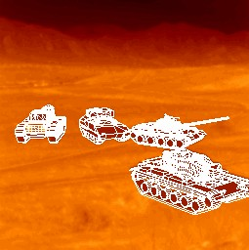
Target Recognition

Slide 31
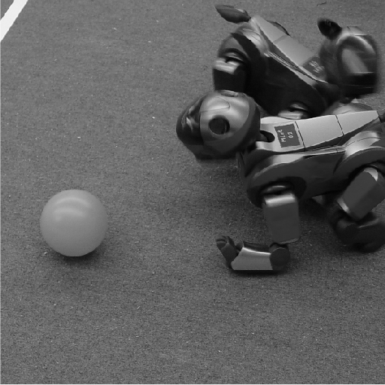
Robotics vision

Slide 32
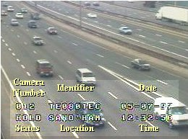
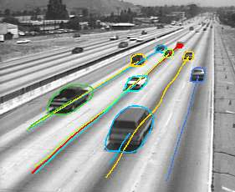
Traffic Monitoring

Slide 33
Thank you
Notes:
A presentation on “Type of Machine Learning with real life example details”

